Slide 1
The Social Brain:
Neuroscience Perspectives on Empathy, Trust and Cooperation
Dr. Jamie Ward
University of Sussex

Slide 2
Overview
Empathy and how it can be studied by neuroscience
  Control of empathy, e.g. as a function of power
Trust and cooperation and how it can be studied by neuroscience
  How it is affected by beliefs about whether partner is human
  Evidence from people high in psychopathy

Slide 3
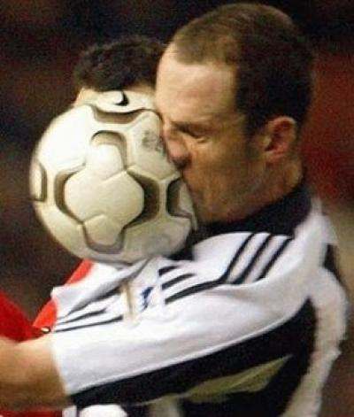
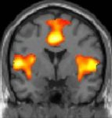
Empathy
Sharing of feelings and thoughts from one person to the next
Neuroscience approach: the idea of simulation
SEE pain
Activity in ‘pain matrix’
of observer

Slide 4
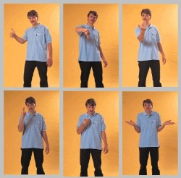
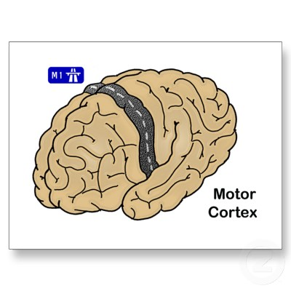
Empathy
Sharing of feelings and thoughts from one person to the next
Neuroscience approach: the idea of simulation
SEE action
Activity in motor system
of observer

Slide 5

Empathy
Sharing of feelings and thoughts from one person to the next
Neuroscience approach: the idea of simulation
SEE action
Activity in motor system
of observer
Hand gesture
IMITATION

Slide 6
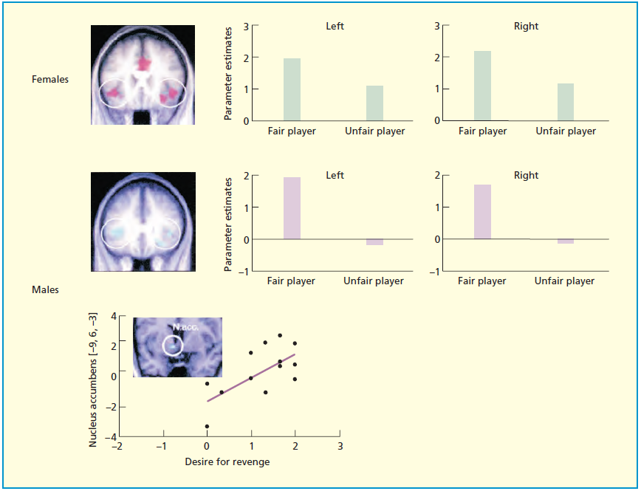
Empathy is Flexible
Singer et al. (2006)

Slide 7
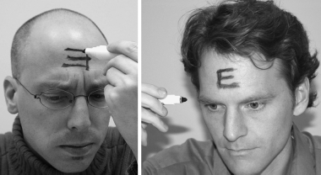
Empathy Depends on Perceived
Social Standing
Shared Pain:
  Less for out-group than in-group (Hein et al. 2010)
Motor Cortical Activity
  Less after ‘power induction’ (Obhi et al.)
Imitation
  Depends on power relationship (Thelen & Kirkland, 1976)
Perspective taking and expression recognition
  Self-biased and impaired after ‘power induction’ (Galinsky et al. 2006)

Slide 8
What Does This Mean?
Not necessarily maladaptive (e.g. Doctors observing pain need to regulate any vicarious response)
Not necessarily the case that powerful people are less empathic (i.e., as a stable trait) – although it could apply to some (psychopathy+leadership)
Suggests that situations in which power relations are salient bias towards an unempathic / self-serving agenda (“people as objects”; Gruenfeld et al. 2008)

Slide 9
Power and Deception
Haselhuhn & Wong (2012)
  Self-reported power questionnaire (e.g. “I can get people to listen to what I say”)
  Measure of cheating: roll a dice twice and type number into computer to determine number of entries into lottery
  → Significant correlation

Slide 10
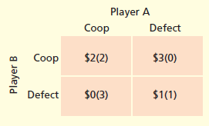
Trust and Cooperation
May be operationalized by Prisoner’s Dilemma
Round Player A Player B Outcome
1
2
3
4
5

Slide 11
Trust and Cooperation
May be operationalized by Prisoner’s Dilemma
Round Player A Player B Outcome
1 Coop Coop
2
3
4
5

Slide 12
Trust and Cooperation
May be operationalized by Prisoner’s Dilemma
Round Player A Player B Outcome
1 Coop Coop $2 + $2
2
3
4
5

Slide 13
Trust and Cooperation
May be operationalized by Prisoner’s Dilemma
Round Player A Player B Outcome
1 Coop Coop $2 + $2
2 Coop Defect
3
4
5

Slide 14
Trust and Cooperation
May be operationalized by Prisoner’s Dilemma
Round Player A Player B Outcome
1 Coop Coop $2 + $2
2 Coop Defect $0 + $3
3
4
5

Slide 15
Trust and Cooperation
May be operationalized by Prisoner’s Dilemma
Round Player A Player B Outcome
1 Coop Coop $2 + $2
2 Coop Defect $0 + $3
3 Defect Defect $1 + $1
4
5

Slide 16
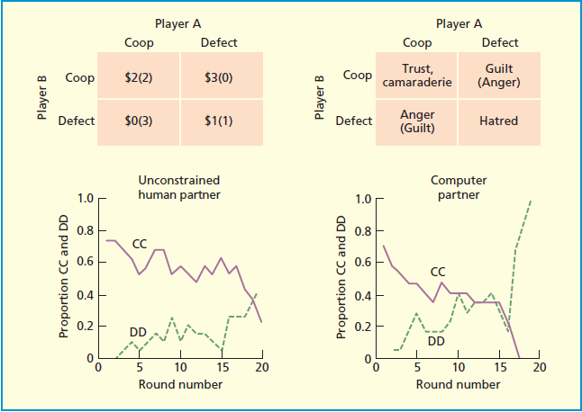
Trust and Cooperation
May be operationalized by Prisoner’s Dilemma

Slide 17
fMRI of Prisoners Dilemma
Rilling et al. (2002)
Mutual cooperation (CC) had highest activity in reward-related regions (nucleus accumbens, OFC) even though this not associated with the maximum monetary rewards
Mutual cooperation when playing the computer was not associated with striatal activity (even though monetary rewards the same as when playing human)
Rilling et al. (2008)
Unreciprocated cooperation (you cooperate, partner defects) associated with amygdala and insula activity and self-reports of anger, irritation, disappointment

Slide 18
What About Power?
It is unknown
But in high-psychopathy levels in general population...
  Less activity in emotional brain during defection (Rilling et al. 2007)
  Less cooperation overall (Mokros et al. 2008)

Slide 19
Dehumanisation
The mere belief that one is interacting with human/non-human affects decision making and reward mechanisms in the brain
Out-groups that are dehumanised don’t activate the same neural circuit (in medial prefrontal lobes) in the same way as thinking about other human groups (Harris & Fiske, 2006)
Dehumanisation may be a cognitive necessity for abuses of power against out-groups

Slide 20
Summary
There is a tendency to share the feelings and thoughts of others (empathy)
  However, this tendency is contextually embedded and power may reduce that tendency
Cooperation is, in itself rewarding, and cheating/non-cooperation elicits a negative emotional response
  The ability to avoid such negative responses (due to emotional control) may lead to exploitation (and abuse of power)

Slide 21
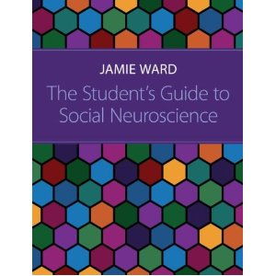
Thanks!
Email: jamiew@sussex.ac.uk
Twitter: @jamiewardsussex

