Slide 1
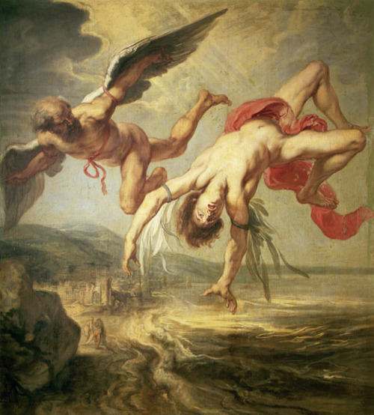
DAEDALUS
TRUST
John Harris

Slide 2
MY TALK
Common sense
Hubris
Leadership
My experience
Mentoring
Thoughts
TRUST
DAEDALUS

Slide 3
HUBRIS
STATUS
AUTHORITY
POWER
THE PA
CAR AND THE CHAUFFEUR
NO LONGER NEED TO CARRY CASH
NO TRAVEL ARRANGEMENTS
DO NOT MANAGE YOUR TIME
DEDICATED TEAM
LIFESTYLE
TRUST
DAEDALUS

Slide 4
HUBRIS
STATUS
AUTHORITY
POWER
THE PA
CAR AND THE CHAUFFEUR
NO LONGER NEED TO CARRY CASH
NO TRAVEL ARRANGEMENTS
DO NOT MANAGE YOUR TIME
DEDICATED TEAM
LIFESTYLE
TRUST
DAEDALUS

Slide 5
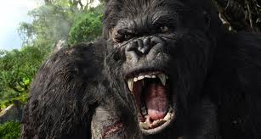
HUBRIS
TRUST
DAEDALUS

Slide 6
VALUES
Capability
Independent thought
TRUST
Consistency
Caring
COURAGE
Reliability
Integrity
TRUST
DAEDALUS

Slide 7
LIFE AT THE TOP
Paid to see the big picture, but knowing the devil is in the detail
Paid to think long term, but you may be in post a few years
In charge, but you have to delegate
Display conviction, but you know life full of uncertainty
Keeping things simple, but not being simplistic
Deal quickly with mistakes, but avoid blame culture & cover-ups
Drive for change & improvement, but stay positive about present
Make time for thinking, but always be ready for action
TRUST
DAEDALUS

Slide 8
MY EXPERIENCE
Incidents
Dilemmas
Difficult situations
Difficult conversations
Decisions
TRUST
DAEDALUS

Slide 9
MENTORING
Gaining insight
Making time for reflection
Action planning
The Issues:
Making things happen or how to deliver results
Having difficult conversations
Dealing with difficult people – sometimes their boss
Dealing with difficult situations
TRUST
DAEDALUS

Slide 10
MENTORING
GOING FOR GOLD
A SAFE SPACE
TRUST
DAEDALUS

Slide 11
What we ask in return is that they stay true...
TRUST
DAEDALUS

Slide 12
DAEDALUS
TRUST
Registered Charity No: 1140239
www.daedalustrust.org.uk

